Slide 1
INS SENSOR CALIBRATION USING ML
Raghunandan
DEAIS
M.Swapna, Sc.E
Dr. Yogeshwar Singh

Slide 2
PROBLEM STATEMENT
Development of a machine learning model to estimate the complete set of INS sensor calibration parameters, including biases, scale factors, and misalignment terms, while accounting for temperature-dependent variations, for accurate modelling and correction of sensor errors, with the objective of reducing calibration time.

Slide 3
LITERATURE SURVEY
Q. Wang, Y. Li, and X. Niu, "Thermal Calibration Procedure and Thermal Characterization of Low-cost Inertial Measurement Units," Journal of Navigation, pp. 1–18, 2015, doi: 10.1017/S0373463315000600. | The study shows that MEMS IMU errors vary significantly with temperature, but reliable thermal calibration especially using averaged thermal models can effectively reduce these errors, improve navigation performance, and require periodic recalibration due to sensor drift over time
N. B. Vavilova, I. A. Vasineva, A. A. Golovan, A. V. Kozlov, I. A. Papusha, and N. A. Parusnikov, "The Calibration Problem in Inertial Navigation," Journal of Mathematical Sciences, vol. 253, no. 6, pp. 839–860, Mar. 2021. doi: 10.1007/s10958-021-05267-9. | The paper presents a bench calibration method for INS that directly uses raw accelerometer and gyroscope data from the assembled system to estimate sensor error parameters and enable effective error compensation in navigation
R. Pesti, P. Sarcevic, and A. Odry, “Artificial neural network-based MEMS accelerometer array calibration,” International Journal of Intelligent Robotics and Applications, 2025, doi: 10.1007/s41315-025-00438-2. | This study proposes an ANN-based calibration method for low-cost accelerometer arrays using multi-IMU data fusion, achieving up to 23% improvement over regular methods and demonstrating strong potential for precise motion sensing and future real-time applications

Slide 4
GENERAL APPROACH
Collect synchronized raw accelerometer readings (X, Y, Z) and temperature data.
Preprocess and align datasets to remove noise and outliers.
Define target calibration parameters (biases, scale factors, misalignment errors) for all axes.
Train a supervised neural network mapping 4 inputs → 12 error parameters. For example, the four inputs can be accel_x, accel_y, accel_z, temp and the 12 outputs can be all error parameters for all three axes
Apply predicted error parameters to generate calibrated accelerometer outputs.
Validate performance against reference measurements.

Slide 5
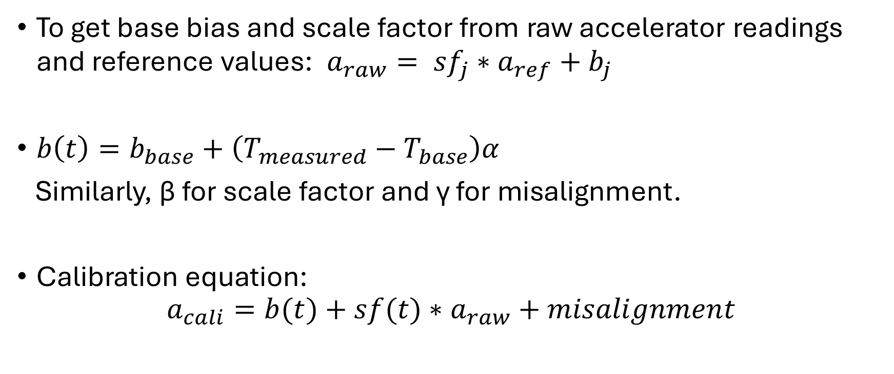
EQUATIONS
To get base bias and scale factor from raw accelerator readings and reference values:$a_{raw}= {sf}_{j}∗a_{ref}+b_{j}$
$b\left(t\right)=b_{base}+\left(T_{measured}−T_{base}\right)α$
Similarly, $\text{β}$ for scale factor and $\text{γ} \text{for} \text{misalignment}$.
Calibration equation:
$$a_{cali}=b(t)+sf(t)∗a_{raw}+misalignment$$

Slide 6
PROGRESS
Checked all datasets
Full Understanding of Feature Set
Studied the process which was used to get the calibrated acceleration values for each x, y, z axis and the equations and steps involved in it to produce the necessary error parameters like bias, scale factor and misalignment for finding the calibrated value
Identifying and Studying Applicable Neural Network Models

